Slide 1

Chapter 3
Introduction
To
Physical
Layer

Slide 2
Chapter 3: Outline
3.1 DATA AND SIGNALS
3.2 PERIODIC ANALOG SIGNALS
3.3 DIGITAL SIGNALS
3.4 TRANSMISSION IMPAIRMENT
3.5 DATA RATE LIMITS
3.6 PERFORMANCE

Slide 3
Chapter 3: Objective
The first section shows how data and signals can be either analog or digital. Analog refers to an entity that is continuous; digital refers to an entity that is discrete.
The second section shows that only periodic analog signals can be used in data communication. The section discusses simple and composite signals. The attributes of analog signals such as period, frequency, and phase are also explained.
The third section shows that only non-periodic digital signals can be used in data communication. The attributes of a digital signal such as bit rate and bit length are discussed. We also show how digital data can be sent using analog signals. Baseband and broadband transmission are also discussed in this section.

Slide 4
Chapter 3: Outline
The fourth section is devoted to transmission impairment. The section shows how attenuation, distortion, and noise can impair a signal.
The fifth section discusses the data rate limit: how many bits per second we can send with the available channel. The data rates of noiseless and noisy channels are examined and compared.
The sixth section discusses the performance of data transmission. Several channel measurements are examined including bandwidth, throughput, latency, and jitter. Performance is an issue that is revisited in several future chapters.

Slide 5
3.1 Data and Signals
A scenario between Alice and Bob
  A scientist (Alice) working in Sky Research needs to order a book related to her research from an online bookseller (Scientific Books).
  Five level communication between Alice and Bob
    Application, Transport, Network, Datalink Layer – Logical communication
    Physical Layer - Physical communication
  Alice and Bob exchange data.
    A signal is exchanged in physical layer.
  Media have to change data to signals.
    Data can be analog or digital
    Signal can be analog or digital

Slide 6
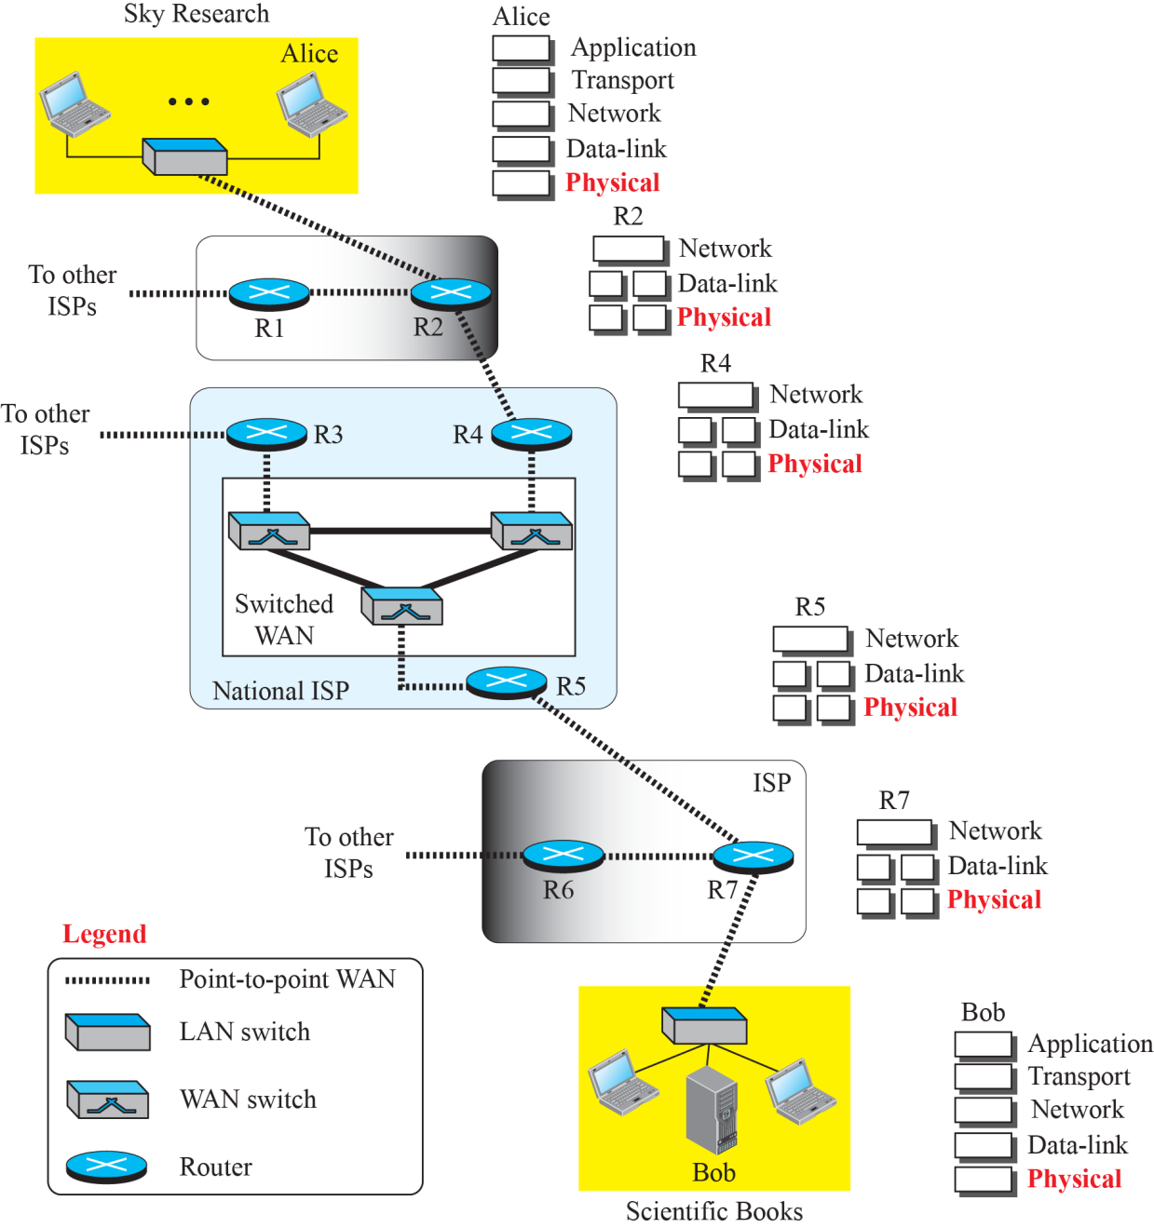
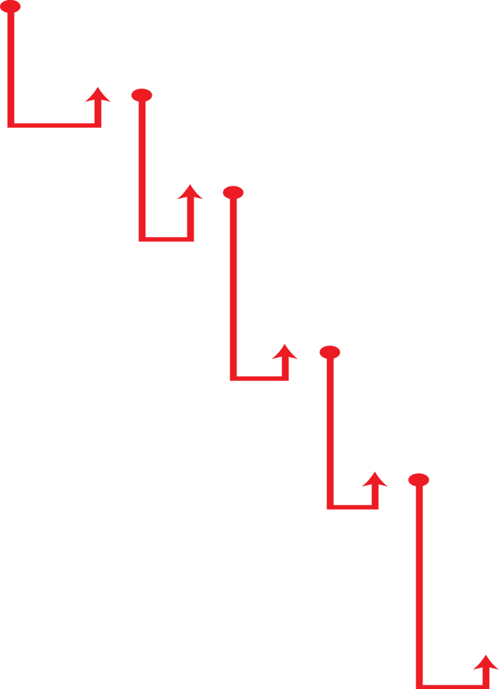
3.1 Data and Signals
Figure 3.1: Communication at the physical layer

Slide 7
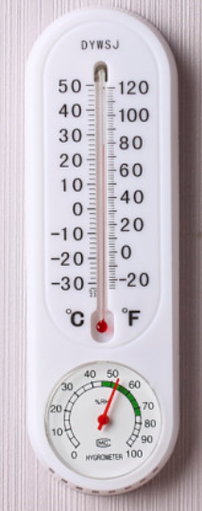

3.1.1 Analog and Digital Data
Data can be analog or digital.
Analog data refers to information that is continuous;
  Ex : Voice, Temperature, Wave of Earthquake
Digital data refers to information that has discrete states;
  Ex : 0 or 1, digital clock

Slide 8
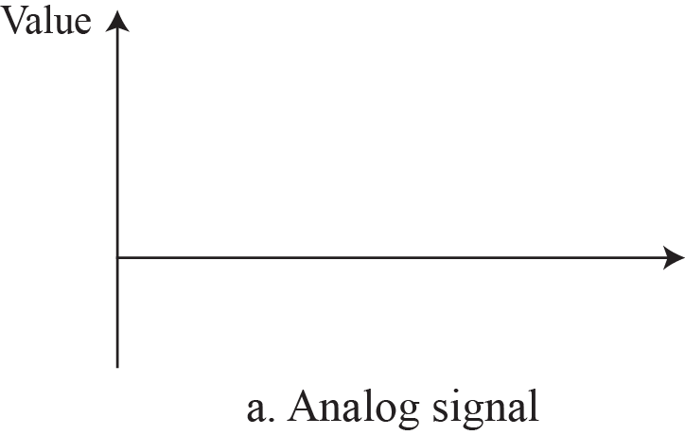
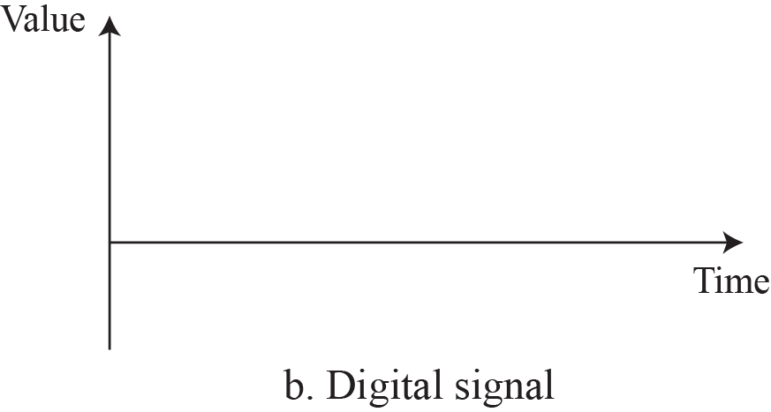


3.1.2 Analog and Digital Signal
Signals can be either analog or digital.
  An analog signal has infinitely many levels of intensity over a period of time.
  A digital signal can have only a limited number of defined values.
Comparison of analog and digital signals

Slide 9
3.1.3 Periodic and Non-periodic Signal
A periodic signal completes a pattern within a measurable time frame, called a period, and repeats that pattern over subsequent identical periods.
  The completion of one pattern is called a cycle.
A nonperiodic signal changes without exhibiting a pattern or cycle that repeats over time.
In data communications, we commonly use
periodic analog signals and nonperiodic digital signals.

Slide 10
3.2 Periodic Analog Signals
Periodic analog signals can be classified as simple or composite.
  A simple periodic analog signal, a sine wave, cannot be decomposed into simpler signals.
  A composite periodic analog signal is composed of multiple sine waves.

Slide 11
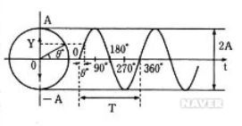
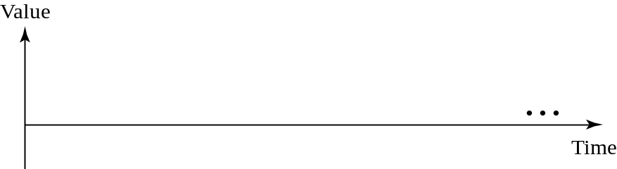

3.2.1 Sine Wave
The sine wave is the most fundamental form of a periodic analog signal.
A sine wave can be represented by three parameters : peak Amplitude, Frequency, Phase.
S(t) = A sin (2π f t + θ)
f is frequency
θ = 0 ~ 360 degree

Slide 12
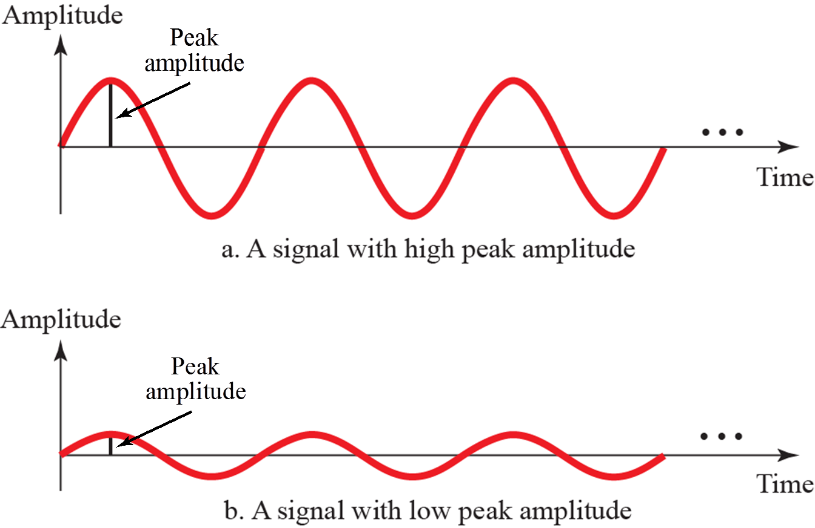
3.2.1 Sine Wave
Two signals with two different amplitudes

Slide 13
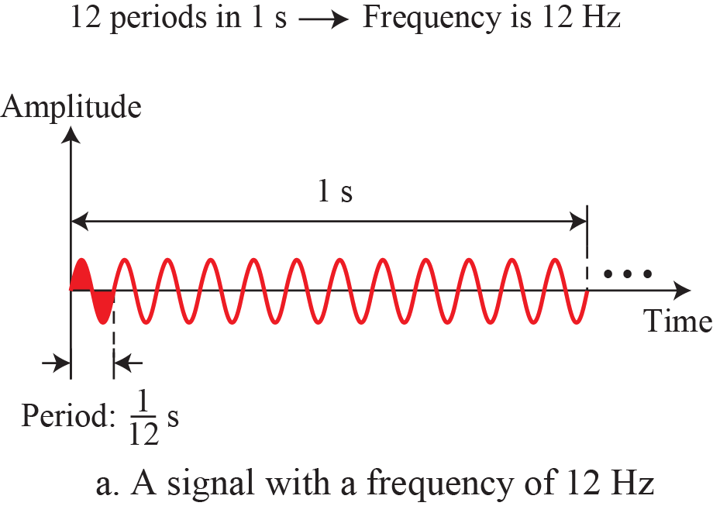
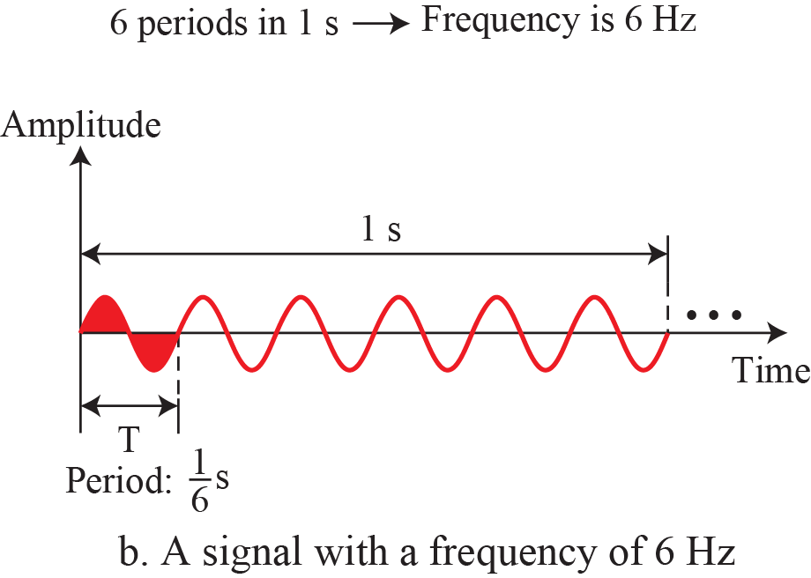
3.2.1 Sine Wave
The same phase and amplitudes, but different frequency.

Slide 14
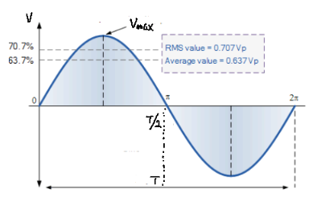


Example 3.1
The power in U.S. can be represented by a sine wave with a peak amplitude (Vmax ) of 155 to 170 V.
  it is known that the voltage of the power in U.S. homes is 110 to 120 V.
  These are root mean square (rms) values.
  Vmax = 2^{½} × V r m s

Slide 15
Example 3.2
The voltage of a battery is a constant.
  This constant value can be considered a sine wave.
  For example, the peak value of an AA battery is normally 1.5V.

Slide 16

3.2.1 Sine Wave
Period (T)
  The amount of time, in seconds, a signal needs to complete 1 cycle.
Frequency (f)
  The number of periods in 1s.
  Expressed in Hertz(Hz)
  It is the rate of change with respect to time.
Frequency(f) and period(T) are the inverse of each other.
If a signal does not change at all, its frequency is zero.
If a signal changes instantaneously, its frequency is infinite.

Slide 17
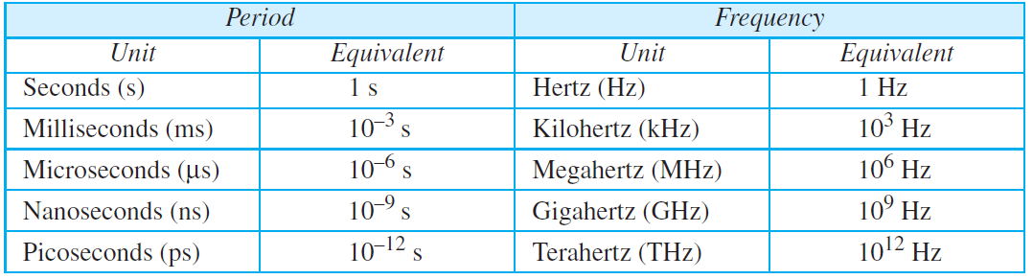
3.2.1 Sine Wave
Unit of Period & Frequency

Slide 18

Example 3.3
The power in U.S. has a frequency of 60Hz (50Hz in Europe).
The period of this sine wave :
  This means that the period of the power for our lights at home is 0.0116 s, or 16.6 ms.
  Our eyes are not sensitive enough to distinguish these rapid changes in amplitude.

Slide 19
Example 3.4
Express a period of 100ms in microseconds.
Solution
1ms is 10⁻³ s , 1s is 10⁶μs.

Slide 20
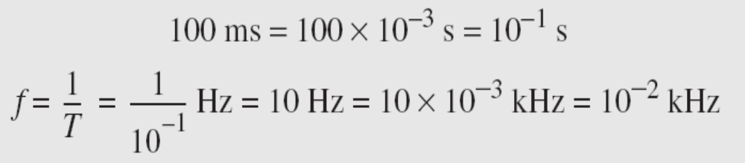
Example 3.5
The period of a signal is 100ms. What is its frequency in kilohertz?
Solution
We change 100 ms to seconds,
And, calculate the frequency from the period(1 Hz = 10⁻³ kHz).

Slide 21
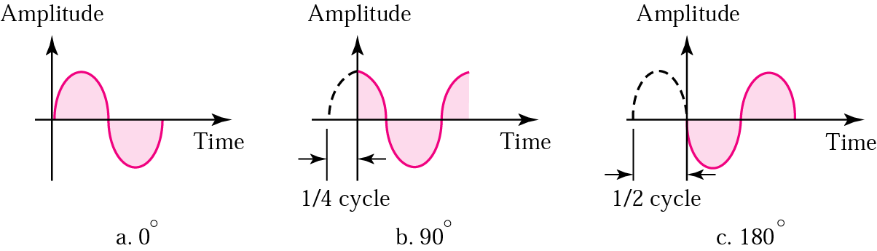
3.2.2 Phase
The term phase describes the position of the waveform relative to time 0.
  If the wave is shifted backward or forward along the time axis, phase describes the amount of that shift.
The status of the first cycle.

Slide 22
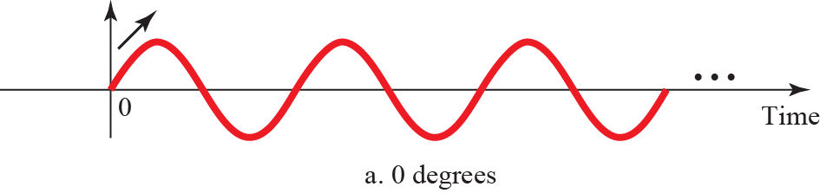
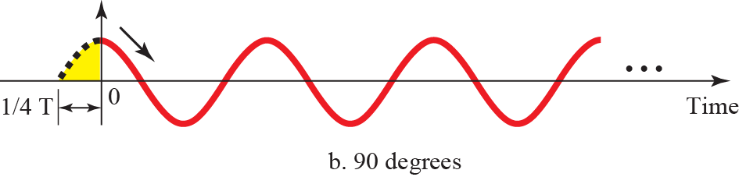
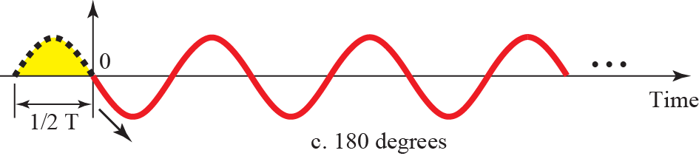
3.2.2 Phase
Three sine waves with different phases

Slide 23

Example 3.6
A sign wave is offset 1/6 cycle with respect to time 0.
What is its phase in degrees and radians?
Solution
1 complete cycle is 360 °.
The degrees and radians of 1/6 cycle is :

Slide 24


3.2.3 Wavelength
Wavelength
  The length that a signal propagates for a period.
  It binds the period or the frequency of a simple sine wave to the propagation speed of the medium.
Wavelength and Period

Slide 25
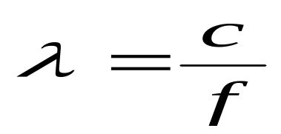
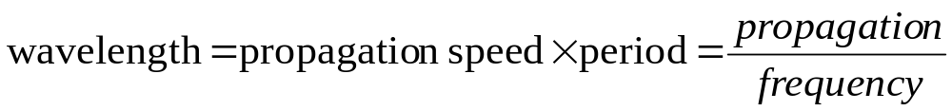
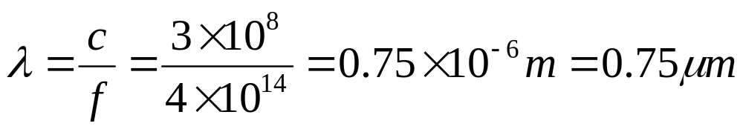
3.2.3 Wavelength
If the propagation speed(c) and the period(T) of a signal is given, wavelength (λ) is can be calculated.
In a vacuum, the speed of light is 3*10⁸ m/s.
The wavelength of red light(f = 4 * 10¹⁴) :
In a coaxial or fiber-optic cable, the wavelength is shorter (0.5μm)
  The propagation speed is decreased in the cable.
speed

Slide 26
3.2.4 Time and Frequency Domains
Time Domain Plot
  It shows changes in signal amplitude with respect to time (it is an amplitude-versus-time plot).
  Phase is not explicitly shown on a time-domain plot.
Frequency Domain Plot
  It shows the relationship between amplitude and frequency.
  It is concerned with only peak value and frequency.
  Changes of amplitude are not shown.

Slide 27
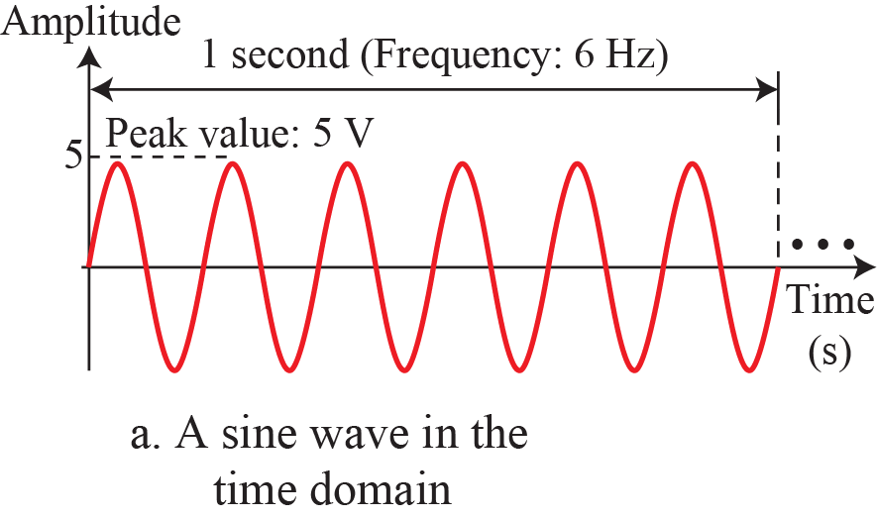
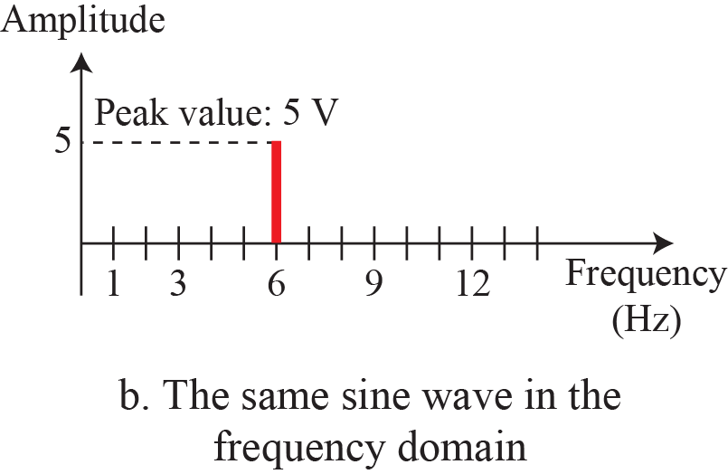
3.2.4 Time and Frequency Domains
Single sine waves
A complete sine wave in the time domain can be represented by one single spike in the frequency domain.

Slide 28
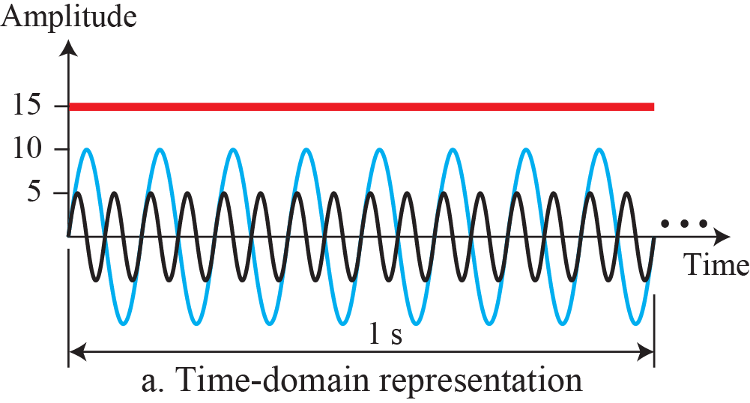
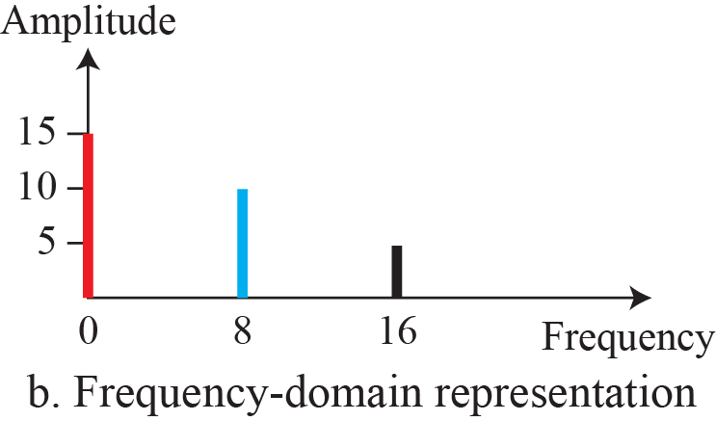
Example 3.7
The frequency domain is more compact and useful when we are dealing with more than one sine wave.
  All can be represented by three spikes in the frequency domain.
Three sine waves with different amplitude and frequency.

Slide 29
3.2.4 Time and Frequency Domains
Figure 3.9: The time domain and frequency domain of three sine waves
A single-frequency sine wave is not useful in data communications;
we need to send a composite signal, a signal made of many simple sine waves.

Slide 30
3.2.5 Composite Signals
Single sine wave
  A example : To distribute electric energy to houses and businesses carrying energy with a frequency of 60Hz.
  Another example : To send an alarm to a security center carrying a signal of danger.
  It would no information over the telephone line. Just hear a buzz.
A single-frequency sine wave is not useful in data communications.
We need to send a composite signal, a signal made of many simple sine waves.

Slide 31
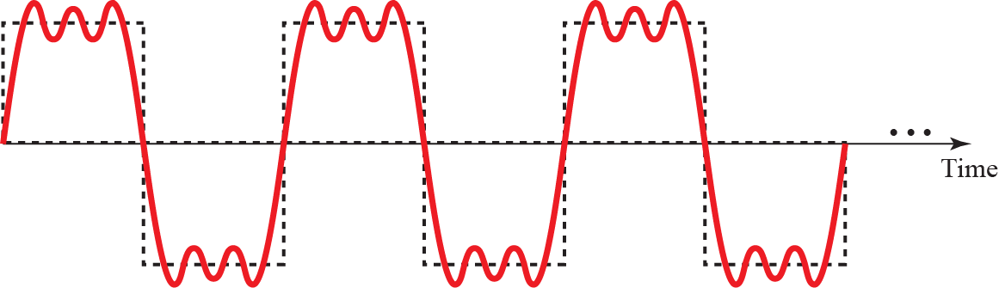
3.2.5 Composite Signals
A periodic composite signal with frequency f.
It is very difficult to manually decompose this signal into a series of simple sine waves.
According to Fourier analysis, any composite signal is a combination of simple sine waves with different frequencies, amplitudes, and phases.

Slide 32
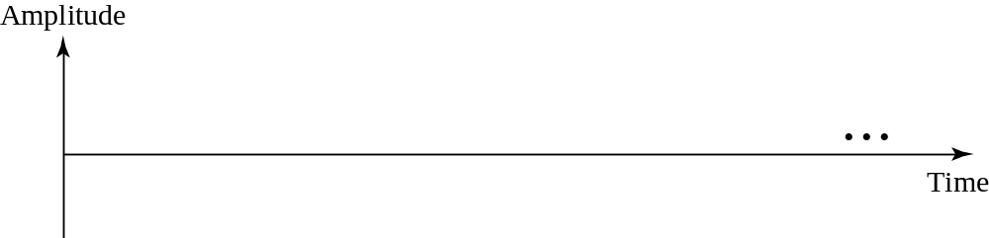

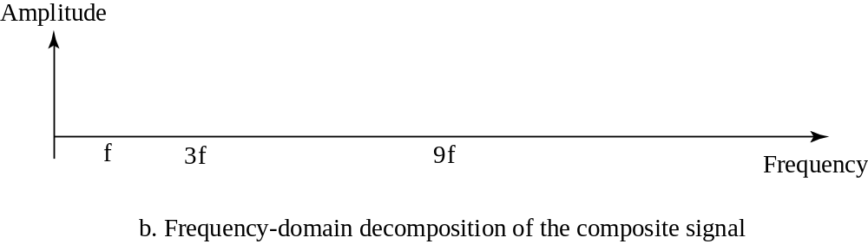
Example 3.8
Decomposition of a composite periodic signal

Slide 33
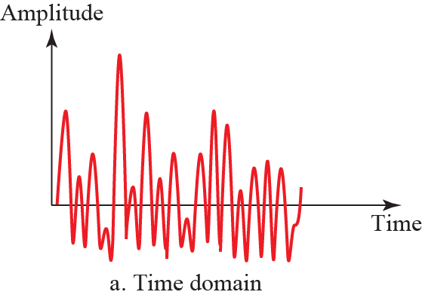
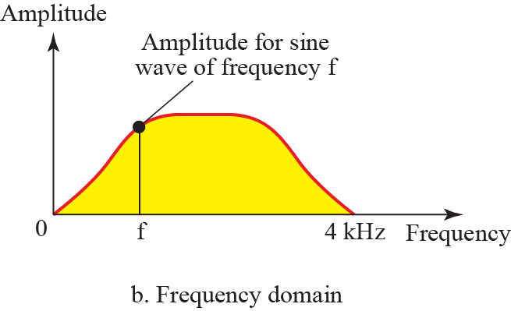
Example 3.9
Nonperiodic composite signal created by a microphone or a telephone.
  A word or two is pronounced.
Figure 3.12: Time and frequency domain of a non-periodic signal

Slide 34
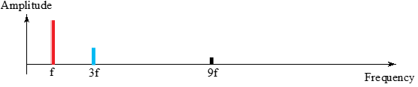
3.2.5 Composite Signals
If the composite signal is periodic, the decomposition gives a series of signals with discrete frequencies.
If the composite signal is nonperiodic, the decomposition gives a series of signals with continuous frequencies.

Slide 35
3.2.6 Bandwidth
The range of frequencies contained in a composite signal is its bandwidth.
  If a composite signal contains frequencies between 1000 and 5000, its bandwidth is 5000 − 1000, or 4000.
The bandwidth of a composite signal is the difference between the highest and the lowest frequencies contained in that signal.

Slide 36
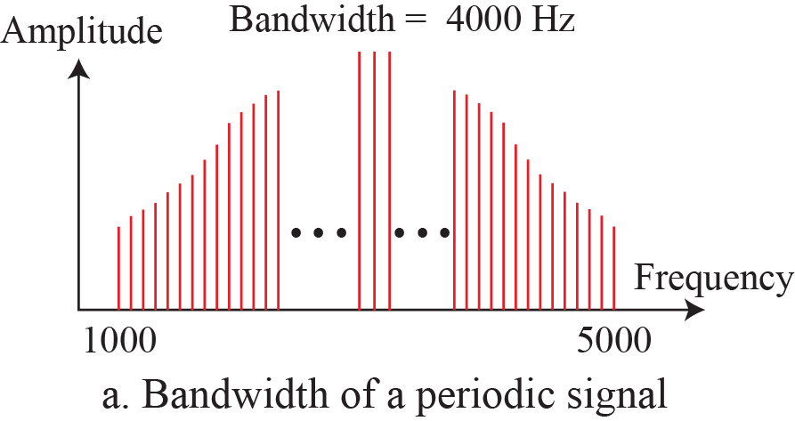
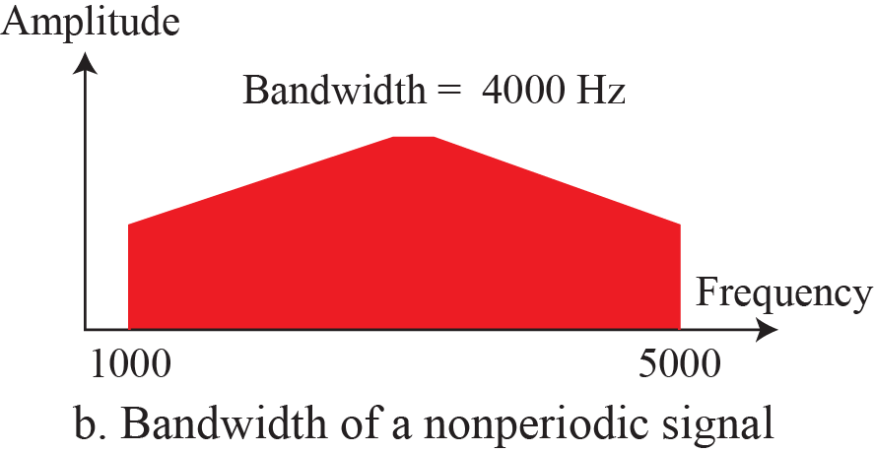
3.2.6 Bandwidth
Figure 3.13: The bandwidth of periodic and nonperiodic composite signals

Slide 37

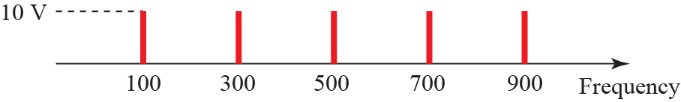

Example 3.10
A periodic signal is decomposed into five sine waves
  The frequencies are 100, 300, 500, 700, and 900 Hz,
what is its bandwidth?
Draw the spectrum. The maximum amplitude is 10V.
Solution

Slide 38
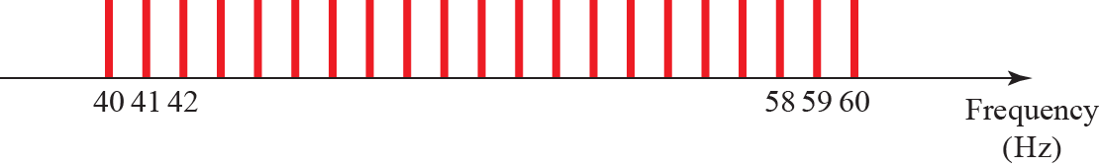
Example 3.11
A periodic signal
  bandwidth is 20Hz. The highest frequency is 60Hz.
What is the lowest frequency?
Draw the spectrum
  The signal contains all frequencies of the same amplitude.
Solution
  B=f_{h}–f_{l} ➔ 20=60–f_{l} ➔ f_{l} =40 Hz

Slide 39
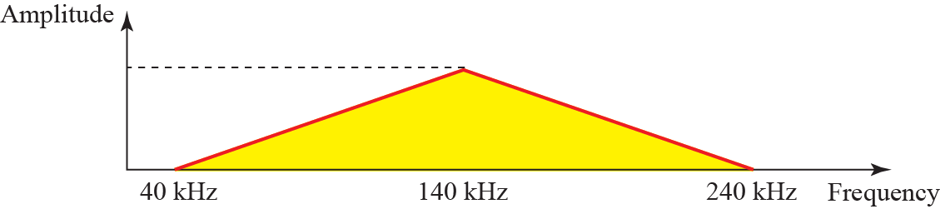
Example 3.12
A nonperiodic composite signal
  bandwidth is 200kHz, middle frequency is 140kHz, and peak amplitude is 20V.
  The two extreme frequencies have an amplitude of 0.
Draw the frequency domain of the signal.
Solution
The highest and lowest frequency is 40Hz and 240Hz, respectively.

Slide 40

Example 3.13
AM Radio Station.
  It propagates nonperiodic composite signal
  In U.S., each AM radio station is assigned a 10-kHz bandwidth.
  The total bandwidth dedicated to AM radio ranges from 530 to 1700 kHz.

Slide 41
Example 3.14
FM Radio Station.
  It propagates nonperiodic composite signal
  In U.S., each FM radio station is assigned a 200-kHz bandwidth.
  The total bandwidth dedicated to FM radio ranges from 88 to 108 MHz.
88
MHz
88.2
107.6
107.8
108
MHz
200kHz
88.4
88.6

Slide 42
Example 3.15
Analog Black & White TV.
  It propagates nonperiodic composite signal
  A TV screen is made up of pixels (picture elements).
    If the resolution is 525×700, there is 367,500 pixels per screen.
    If we scan the screen 30 times per second, there is 367,500×30 =11,025,000 pixel per second.
  We can send 2 pixels per cycle.
    we need 11,025,000/2 = 5,512,500 cycles per second, or Hz.
  The bandwidth needed is 5.5124MHz.
    If we need only 70 percent of this bandwidth, which is 3.85MHz.
    Since audio and synchronization signals are also needed, a 4-MHz bandwidth has been set for each black and white TV channel.
    An analog color TV channel has a 6-MHz bandwidth.

Slide 43
3.3 Digital Signals
Information can also be represented by a digital signal.
  For example, a 1 can be encoded as a positive voltage and a 0 as zero voltage.
A digital signal can have more than two levels.
  In this case, we can send more than 1 bit for each level.
  Figure 3.17 shows two signals, one with two levels and the other with four levels.
Topics discussed in this section:
3.3.1 Bit Rate
3.3.2 Bit Length
3.3.3 Digital Signal as a Composite Analog Signal
3.3.4 Transmission of Digital Signals

Slide 44
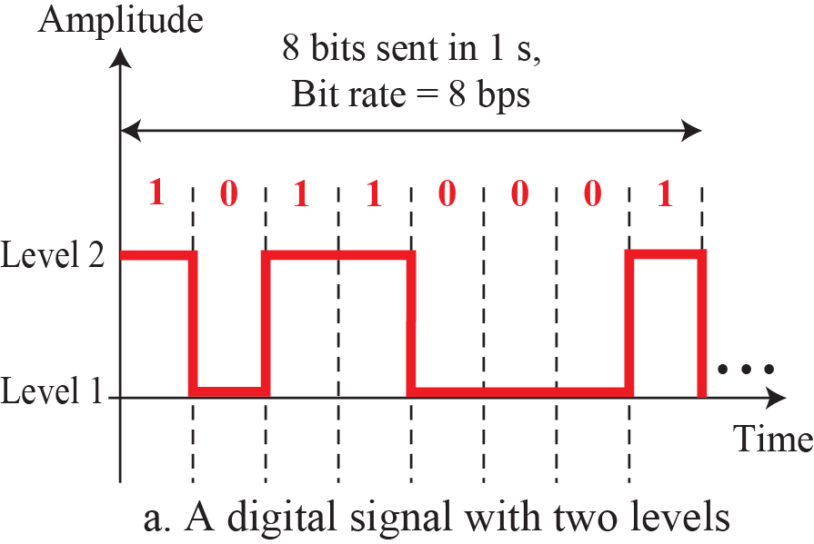
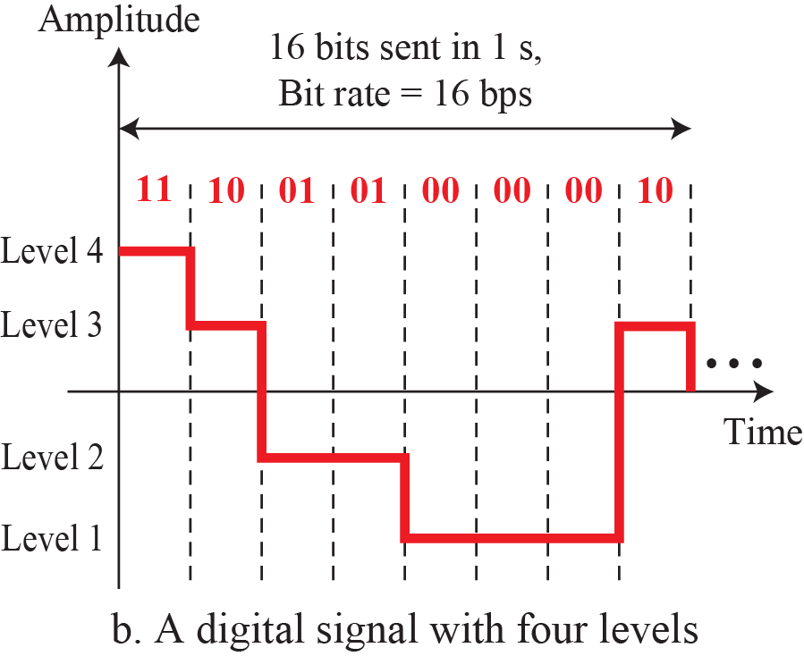
Figure 3.17: Two digital signals: one with two signal levels and the
other with four signal levels
Signal Rate : 8baud
Data Rate : 8bps
Signal Rate : 8baud
Data Rate : 16bps
1.<number>
Notes:
1.#

Slide 45

Example 3.16, 3.17
A digital signal has 8 levels. How many bits are needed per level?
  Each signal level is represented by 3 bits.
A digital signal has 9 levels. How many bits are needed per level?
  Each signal level is represented by 3.17 bits. ➔ 4 bits.
  The number of bits per level needs to be an integer and power of 2.

Slide 46
3.3.1 Bit Rate
Bit Rate
  Most digital signals are nonperiodic.
    period and frequency are not appropriate to describe the digital signals.
  Bit rate (instead of frequency) is used to describe digital signals.
  The bit rate is the number of bits sent in 1s,
  expressed in bits per second (bps).

Slide 47

Example 3.18
Assume we need to download text documents at the rate of 100 pages per second.
What is the required bit rate of the channel?
Solution
A page is composed of 24 lines, a line is compose of 80 characters.
8 bit is deeded for 1 character.

Slide 48

Example 3.19
Digitizing a 4-kHz bandwidth analog voice signal
  We need to sample the signal at twice the highest frequency (two samples per hertz).
  We assume that each sample requires 8 bits.
  What is the required bit rate?
Solution

Slide 49
Example 3.20
What is the bit rate for high-definition TV (HDTV)?
Solution
HDTV uses digital signals to broadcast high quality video signals.
The HDTV screen is normally a ratio of 16 : 9.
  There are 1920 by 1080 pixels per screen.
  The screen is renewed 30 times per second.
  Twenty-four bits represents one color pixel.
The TV stations reduce this rate to 20 to 40 Mbps through compression.

Slide 50

3.3.2 Bit Length
Wave Length for an analog signal
  the distance one cycle occupies on the transmission medium.
Bit Length for an digital signal
  The distance one bit occupies in the transmission medium.
  Bit length = propagation speed x bit duration
speed

Slide 51
3.3.3 Digital as Composite Analog
A digital signal is a composite analog signal and it’s bandwidth is infinite.
A digital signal connected vertical and horizontal line segments in the time domain.
  Vertical line means a frequency of infinity.
  Horizontal line means a frequency of zero.
Going from a frequency of zero to infinity implies all frequencies in between are part of the domain.

Slide 52
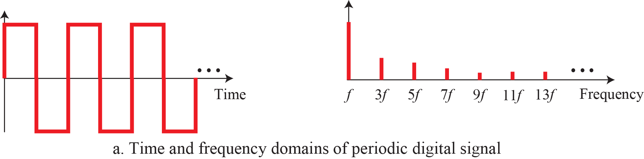
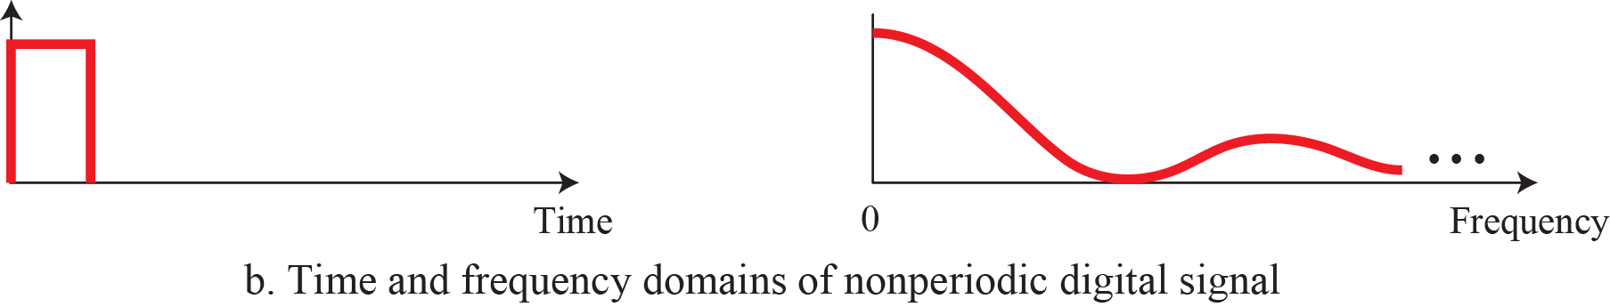
3.3.3 Digital as Composite Analog
The time and frequency domains of periodic and nonperiodic digital signals

Slide 53
3.3.4 Transmission of Digital Signals
A digital signal is a composite analog signal with an infinite bandwidth.
Transmission of Digital Signals
  Baseband Transmission
  Broadband Transmission

Slide 54
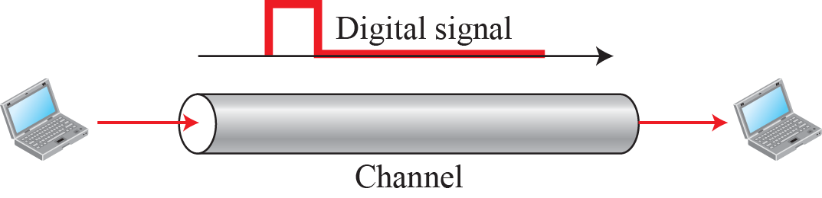
3.3.4 Transmission of Digital Signals
Baseband Transmission
  It means sending a digital signal over a channel without changing the digital signal to an analog signal.
  Baseband transmission requires dedicated low-pass channel with a bandwidth that starts from zero.
  Baseband can be synonymous with low-pass or non-modulated

Slide 55
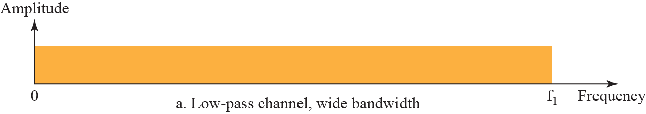
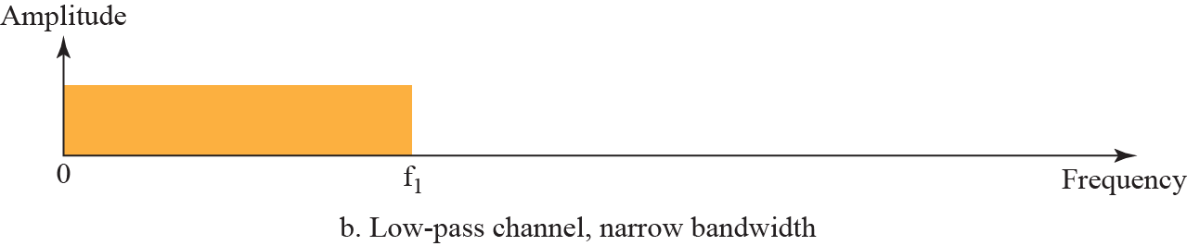
3.3.4 Transmission of Digital Signals
Baseband transmission of a digital signal that preserves the shape of the digital signal is possible only if we have a low-pass channel with an infinite or very wide bandwidth.

Slide 56
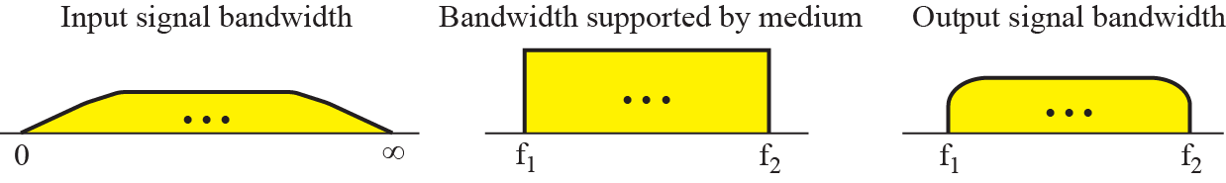
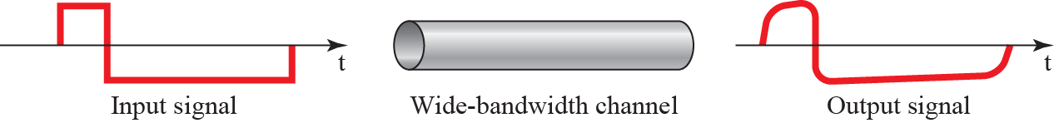
3.3.4 Transmission of Digital Signals
Case 1: Low-pass Channel with Wide Bandwidth
  Dedicated medium with an infinite bandwidth between sender and receiver
  f1 is close to zero, and f2 is very high.
  An example of a dedicated channel where the entire bandwidth is used as one single channel is a LAN.

Slide 57

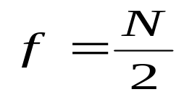
3.3.4 Transmission of Digital Signals
Case 2 : Low-pass Channel with Limited Bandwidth
  Approximate the digital signal with an analog signal.
    The level of approximation depends on the bandwidth.
  Rough Approximation
    A maximum number of changes in digital signal :
      0101010101···· or 1010101010 ····
    To simulate these two case, we need an analog signal with frequency , is bit rate.
    Bandwidth
1
1
1
0
0
0

Slide 58
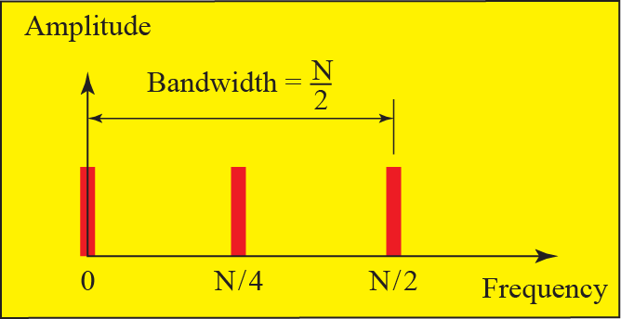
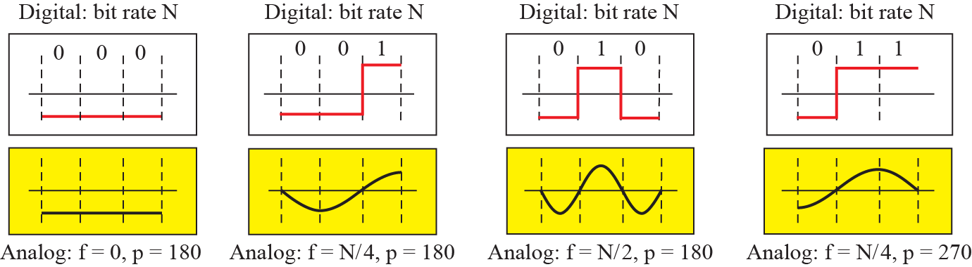
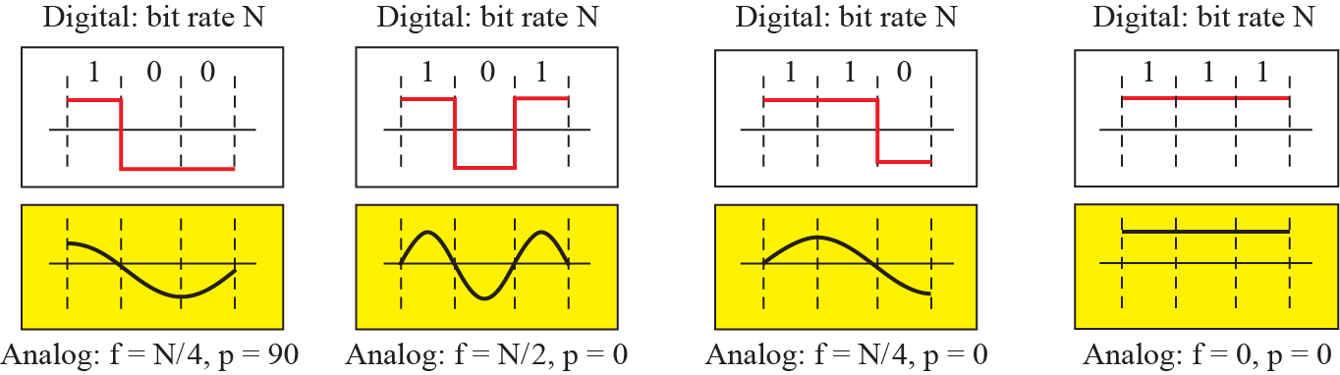
3.3.4 Transmission of Digital Signals
Rough Approximation using first harmonic for worst case

Slide 59
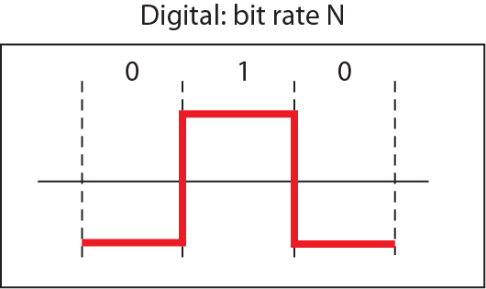
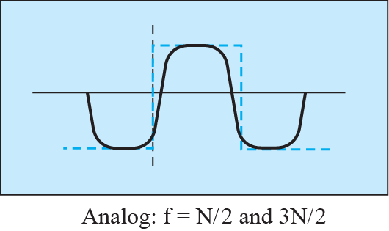



3.3.4 Transmission of Digital Signals
Better Approximation
  We need to add more harmonics and increase the bandwidth.
  Simulating a digital signal with first three harmonics

Slide 60

3.3.4 Transmission of Digital Signals
In baseband transmission, the required bandwidth is proportional to the bit rate.
If we need to send bits faster, we need more bandwidth.
Required Bandwidth :
Table 3.2 Bandwidth requirements

Slide 61
Example 3.22
If we need to send 1Mbps by using baseband transmission, what is the required bandwidth of a low-pass channel?
Solution
a. The minimum bandwidth can be achieved by only first harmonic.
The minimum bandwidth B = Bit Rate (1M) / 2 = 500kHz.
b. A better result can be achieved by using the first and third harmonics.
The required bandwidth is B = 3 × 500 kHz = 1.5MHz.
c. A still better result can be achieved by using the first, third, and fifth harmonics.
The required bandwidth is B = 5 × 500 kHz = 2.5MHz.

Slide 62
Example 3.23
We have a low-pass channel with bandwidth 100 kHz.
What is the maximum bit rate of this channel
Solution
The maximum bit rate can be achieved if we use the first harmonic.
The bit rate is 2 times the available bandwidth, or 200 kbps.

Slide 63

3.3.4 Transmission of Digital Signals
Broadband Transmission(Using Modulation)
  If the available channel is a bandpass channel, we cannot send the digital signal directly to the channel;
  we need to convert the digital signal to an analog signal before transmission. (Modulation)
  If an analog signal is modulated, it can transmitted through the band-pass channel.

Slide 64







3.3.4 Transmission of Digital Signals
Amlpitude Modulation
Figure 3.25: Modulation of a digital signal for transmission on band-pass channel

Slide 65
Example 3.24
Broadband transmission Ex-1.
  Sending of computer data through a telephone subscriber line.
  Telephone lines carry voice (analog signal) with a limited bandwidth : baseband , bandpass channel.
    The bandwidth is so narrow (4kHz) that it is used for low-pass, baseband transmission
    The channel can be considered a bandpass, because a MODEM converts the digital signal from the computer to an analog signal, and sends the analog signal.
  MODEM : Modulation/Demodulation.

Slide 66
Example 3.25
Broadband Transmission Ex-2.
  Digital cellular telephone
    It convert the analog voice signal to a digital signal.
    Bandpass channel is available between caller and callee.
    We need to convert the digitized voice to a composite analog signal before sending.

Slide 67

3.4 Transmission Impairment
Signals travel through transmission media, which are not perfect.
  The imperfection causes signal impairment.
  What is sent is not what is received.
Three causes of impairment are attenuation, distortion, and noise

Slide 68




3.4.1 Attenuation
Attenuation means a loss of energy.
  When a signal travels through a medium, it loses some of its energy.
Amplifiers are used to amplify the signal.

Slide 69


3.4.1 Attenuation
Decibel(dB)
  It measures the relative strengths of two signals at two different points.
  Decibel is negative if a signal is attenuated and positive if a signal is amplified.
  P₁ and P₂ are the power of a signal at point 1, and 2, respectively.

Slide 70
Example 3.26
Suppose a signal travels through a transmission medium and its power is reduced to one half.
  This means that P2 = 0.5P1.
In this case, the attenuation (loss of power) can be calculated as
  A loss of 3 dB (−3 dB) is equivalent to losing one-half the power.

Slide 71

Example 3.27
A signal travels through an amplifier, and its power is increased 10 times.
  This means that P2 = 10P1.
  The amplification (gain of power) can be calculated as

Slide 72


Example 3.28
Decibel numbers can be added (or subtracted) when measured several points.
  The decibel value for the signal can be calculated just by adding the decibel measurements between each points.

Slide 73
Example 3.29
The decibel is used to measure signal power in milliwatts.
  It is referred to as dB_{m}
  It is calculated as dB_{m} = 10 log10 P_{m}
    where Pm is the power in milliwatts.
If dB_{m} = −30, calculate the power of a signal.
Solution
P_{m}

Slide 74

Example 3.30
A signal has −0.3 dB/km and a power of 2 mW at the beginning of a cable.
  The loss in a cable is can defined in decibels per kilometer (dB/km).
What is the power of the signal at 5 km?
Solution
  The loss in the cable is 5×(−0.3) = −1.5dB.
  The power is :

Slide 75


3.4.2 Distortion
The signal can be changed its form or shape.
Distortion can occur in a composite signal made of different frequencies.
  Each signal component has its own propagation speed through a medium and its own delay.
  Differences in delay may create a difference in phase if the delay is not exactly the same as the period duration.

Slide 76



3.4.3 Noise
Thermal noise is the random motion of electrons in a wire, which creates an extra signal not originally sent by the transmitter.
Induced noise comes from sources such as motors.
Crosstalk is the effect of one wire on the other.
Impulse Noise – spike or lighting from external

Slide 77

3.4.3 Noise
Signal-to-Noise Ration (SNR)
  The ratio of the signal power to the noise power
  SNR is the ratio of two powers.
  So, it often described in decibel units, SNR_{dB}.
  SNR_{dB} = 10log₁₀SNR

Slide 78


3.4.3 Noise
Figure 3.31: Two cases of SNR: a high SNR and a low SNR

Slide 79
Example 3.31
The power of a signal is 10mW and the power of the noise is 1μW.
What are the values of SNR and SNR_{dB} ?
Solution

Slide 80
Example 3.32
The values of SNR and SNR_{dB} for a noiseless channel are
  This ratio can never achieved in real life; it is an ideal.

Slide 81
3.5 Data Rate Limits
How fast we can send data, in bits per second, over a channel?
Data rate depends on three factor :
  Available Bandwidth
  Signal Level
  Quality of Channel(Noise)
Two theoretical formulas were developed to calculate the data rate:
  Nyquist Bit Rate for a noiseless channel
  Shannon Capacity for a noisy channel.
Bit Rate = 2×Bandwidth×log₂L
Capacity = Bandwidth×log₂(1+SNR)

Slide 82
3.5.1 Nyquist Bit Rate
Nyquist Bit Rate – Noiseless Channel
  This formula defines the theoretical maximum bit rate.
    L is the number of signal levels
    Bit Rate is bit per second
Bit Rate = 2 × Bandwidth × log₂L

Slide 83
Example 3.34 3.35
Consider a noiseless channel with a bandwidth of 3000 Hz transmitting a signal with two signal levels. What is the maximum bit rate?
Consider the same noiseless channel transmitting a signal with four signal levels (for each level, we send 2 bits). What is the maximum bit rate?
Bit Rate = 2 × Bandwidth × log₂L
= 2×3,000×log₂2 = 6,000bps
Bit Rate = 2 × Bandwidth × log₂L
= 2×3,000×log₂4 = 12,000bps

Slide 84
Example 3.36
We need to send 265 kbps over a noiseless channel with a bandwidth of 20 kHz.
How many signal levels do we need?
Solution
Use the Nyquist formula
  The result is not a power of 2.
  If we have 128(=2⁷) levels, the bit rate is 280kbps.
  If we have 64(=2⁶) levels, the bit rate is 240kbps.

Slide 85
3.5.2 Shannon Capacity
Shannon Capacity– Noisy Channel
  In reality, the channel is always noisy.
  Shannon capacity is to determine the theoretical highest data rate for a noisy channel:
    Bandwidth of the channel
    SNR is signal-to-noise ratio.
    Capacity of the channel is presented by bps.
Capacity(C) = Bandwidth×log₂(1+SNR)

Slide 86
Example 3.37
Extremely noisy channel
  the value of the signal-to-noise ratio is almost zero.
  The noise is so strong that the signal is faint.
  The capacity zero. Any data cannot be received through this channel.
Capacity = Bandwidth×log₂(1+SNR)
  C = B log₂(1+SNR) = B log₂ (1+0) = B log₂ (1)
  = B×0 = 0

Slide 87
Example 3.38
Theoretical highest bit rate of a regular telephone line
  The highest bit rate for a telephone line is 34.860 kbps.
    A telephone line normally has a bandwidth of 3000 Hz.
    The signal-to-noise ratio is usually 3,162(35dB).
  If we want to send data faster than this,
    we can either increase the bandwidth of the line
    or improve the signal-to-noise ratio.
Capacity = Bandwidth×log₂(1+SNR)
  C = B × log₂(1+SNR) = 3,000 × log₂(1+3,162)
  = 3,000 × log₂(3,163) = 3,000 × 11.62
  = 34,860bps

Slide 88

Example 3.39
The signal-to-noise ratio is often given in decibels.
SNR_{dB} =36 and the channel bandwidth is 2MHz.
The theoretical channel capacity can be calculated as :

Slide 89


Example 3.40
When the SNR is very high, we can assume that SNR + 1 is almost the same as SNR.
In these cases, the theoretical channel capacity can be simplified as :
The theoretical channel capacity of the previous example :
C = B×log₂(1+SNR)

Slide 90
3.5.3 Using Both Limits
In practice, we need to use both methods (Nyquist Bit Rate, Shannon Capacity) to find the bit rates and signal levels.

Slide 91
Example 3.41
We have a channel with a 1-MHz bandwidth.
  The SNR for this channel is 63.
  What are the appropriate bit rate and signal level?
Solution
  Shannon formula to find the upper limit of Bit Rate.
  C = B×log₂(1+SNR) = 10⁶×log₂(1+63) = 10⁶×log₂(2⁶)
  = 6Mbps
  For better performance we choose 4Mbps.
  Nyquist formula to find the number of Signal Levels.
  C = 2×B(1MHz)×log₂L = 4Mbps log₂L = 2
  L = 2² = 4

Slide 92
3.6 Performance
One important issue in networking is the Performance of the network—how good is it?
Topics discussed in this section:
3.6.1. Bandwidth
3.6.2. Throughput
3.6.3. Latency (Delay)
3.6.4. Bandwidth-Delay Product

Slide 93
3.6.1 Bandwidth
One characteristic that measures network performance is bandwidth.
Bandwidth can be used in two different contexts with two different measuring values:
  Bandwidth in hertz
  Bandwidth in bits per second
❏ Bandwidth in hertz
  The range of frequencies contained in composite signal
  The range of frequencies a channel can pass
❏ Bandwidth in bits per second
  The number of bits per second that a channel can transmit

Slide 94
Example 3.42 Example 3.43
The bandwidth of a telephone subscriber line is 4kHz for voice or data.
The bandwidth of this line for data transmission can be up to 56Kbps using a sophisticated modem to change the digital signal to analog.
If the telephone company the bandwidth to 8kHz, we can send 112Kbps.
Bit Rate = 2 × Bandwidth × log₂L
= 2 × 4K × log₂2⁷ = 56K

Slide 95

3.6.2 Throughput
Throughput
  a measure of how fast we can actually send data through a network.
  A link with a bandwidth of B bps,
    We can only send T bps through this link. (Throughput is T bps)
    T always less than B.

Slide 96

Example 3.44
A network with bandwidth of 10Mbps can pass only an average of 12,000 frames per minute.
  Each frame is carrying an average of 10Kbits.
  What is the throughput of this network?
Solution
  The throughput is almost one-fifth of the bandwidth

Slide 97

3.6.3 Delay or Latency
Latency (or Delay)
  how long it takes for an entire message to completely arrive at the destination from the source.
  Latency is made of four components:
  Latency = propagation time + transmission time +
  queuing Time + processing delay
(Tt)

Slide 98
3.6.3 지연(Delay, Latency)
Propagation Time
  비트가 발신지에서 목적지까지 이동하는데 걸리는 시간
  전파시간 = 거리 / 전파속도
  진공에서 빛의 전파 속도 = 3 x 10⁸ m/s
(Tt)

Slide 99

Example 3.45
What is the propagation time?
  The distance between the two points is 12,000km
  The propagation speed is 2.4×10⁸ m/s in cable.
Solution
A bit can go over the Atlantic Ocean in only 50ms if there is a direct cable between the source and the destination.

Slide 100
3.6.3 Delay or Latency
Transmission time
  The time to transmit a message
  It depends on the size of the message and the bandwidth of the channel
  Transmission time = (Message size) / Bandwidth
Queuing Time
  The time needed for each intermediate or end device to hold the message before it can be processed

Slide 101

Example 3.46
What are the propagation and transmission time?
  2.5KByte message is sent to the network of 1Gbps bandwidth.
  The distance is 12,000km, and the light travels at 2.4×10⁸ m/s.
Solution
  The message is short and the bandwidth is high
  The dominant factor is the propagation time, not the transmission time.

Slide 102

Example 3.47
What are the propagation and transmission time?
  5KByte message is sent to the network of 1Mbps bandwidth.
  The distance is 12,000km, and the light travels at 2.4×10⁸ m/s.
Solution
  The message is longer and the bandwidth is lower than Example 3.46.
  The dominant factor is the transmission time, not the propagation time.

Slide 103

3.6.4 Bandwidth-Delay Product
Bandwidth-Delay Product
  bandwidth x delay
Case 1 :
  Bandwidth : 1bps, Link delay : 5s

Slide 104

3.6.4 Bandwidth-Delay Product
Case 2 :
  Bandwidth : 5bps, Link delay : 5s

Slide 105



Example 3.48
Concept of bandwidth-delay product
  링크를 두 지점을 연결하는 파이프로 생각
    파이프 단면 : 대역폭
    파이프 길이: 지연
대역폭-지연 곱은 링크를 채울 수 있는 비트의
개수를 의미한다.

Slide 106
3.6 Jitter
Jitter
  Different packets of data have different delays at the receiver site.
  Some application using these data at the receiver site may has time-sensitive (audio and video data, for example).
  Jitter is related to these delays.
    If the delay for the first packet is 20ms, for the second is 45ms, and for the third is 40ms,
    then the real-time application that uses the packets endures
    jitter.

Slide 107

3.7 Summary
Analog & Digital
  Data can be analog or digital
  Signal can be analog or digital
In data communication, we use periodic analog signal or nonperiodic digital signal.
  Sine Wave - Frequency, Amplitude, Phase
  Composite Signal - Bandwidth
A digital signal is a composite analog signal with an infinite bandwidth.
  Baseband Transmission is possible in a low-pass channel with a infinite or very wide bandwidth.
  In a band-pass channel, a digital signal needs to be converted to an analog signal.

Slide 108

3.7 Summary
Bit Rate
  Nyquist bit rate formula defines maximum bit rate for a noiseless channel.
  Shannon capacity is used to find the maximum bit rate for a noisy channel.
Transmission Impairment
  Attenuation, distortion, and noise can impair a signal.
Data Rate Limit
  how many bits per second we can send with the available channel?
Performance
  bandwidth, throughput, latency, and jitter

Slide 109

3.7 Summary
Bit Rate
  Nyquist bit rate formula defines maximum bit rate for a noiseless channel.
  Shannon capacity is used to find the maximum bit rate for a noisy channel.
Attenuation, distortion, and noise can impair a signal.

